Slide 1
CSE3513
Module-I: Introduction to NoSQL and Aggregate-Oriented Data Models
Ref – T1 Chapter 1-5, Docs, Links

Slide 2
Agenda
Brief Introduction
Modules
Q and A
Home Task
Outcome

Slide 3
Introduction
Databases are like television. There was a time in the history of both when you had few options to choose from and all the choices were disappointingly similar. Times have changed. The database management system is no longer synonymous with relational databases, and television is no longer limited to a handful of networks broadcasting indistinguishable programs.

Slide 4
Introduction
Names like PostgreSQL, MySQL, Oracle, Microsoft SQL Server, and IBM DB2 are well known in the IT community, even among professionals outside the data management arena. Relational databases have been the choice of data management professionals for decades. They meet the needs of businesses tracking packages and account balances as well as scientists studying bacteria and human diseases. They keep data logically organized and easily retrieved. One of their most important characteristics is their ability to give multiple users a consistent view of data no matter how many changes are under way within the database.

Slide 5
Introduction : Different DB for different needs.
Anyone who started to work with data management systems in the past two decades might understandably assume that data management is synonymous with relational database management systems.
It is not.
Prior to the advent of the relational database management systems, such as Microsoft Access, Microsoft SQL Server, Oracle relational database, and IBM’s DB2, computer scientists and information technology professionals created a variety of data management systems based on different organizing principles. The data management community has recently taken on new types of data management problems that have prompted the development of new kinds of data management systems. These are collectively known as NoSQL databases.

Slide 6
Introduction : RDBMS
Relational databases are well designed to support hundreds and even thousands of users simultaneously. Even large enterprises can support complex applications serving thousands of users. As businesses and researchers developed new types of applications designed for the Web, they realized that relational databases were not always meeting their needs.
Web applications may need to support tens of thousands of users or more. Some of the most important features of relational databases, such as ensuring anyone reading data will have a consistent view of the data, require time, storage, and computational resources. These types of features are vital to some applications.
For example, if you were to transfer $100 from your savings account to your checking account, it requires two steps: Deduct $100 from your savings account and add $100 to your checking account. If you were to read your account balances after the $100 was deducted from your savings account but before it was added to your checking account, you would appear to be missing $100. Relational databases can group a set of operations, like deducting from savings and adding to checking accounts, as a single operation. If you were to read your balances, you would see the balances either before or after the transfer —never in the middle of the set of operations.
E-commerce Application etc.

Slide 7
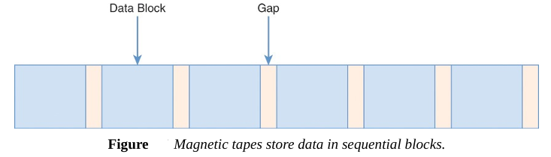
Introduction : Early Database Management Systems
Flat file data management systems
A magnetic tape is divided into a series of blocks with gaps between them
Data is written to blocks by recording heads in a tape drive. Data is read by moving the tape over heads as well.
Reading a tape at a particular block and then read the following blocks in sequence. This is known as sequential access to data.

Slide 8
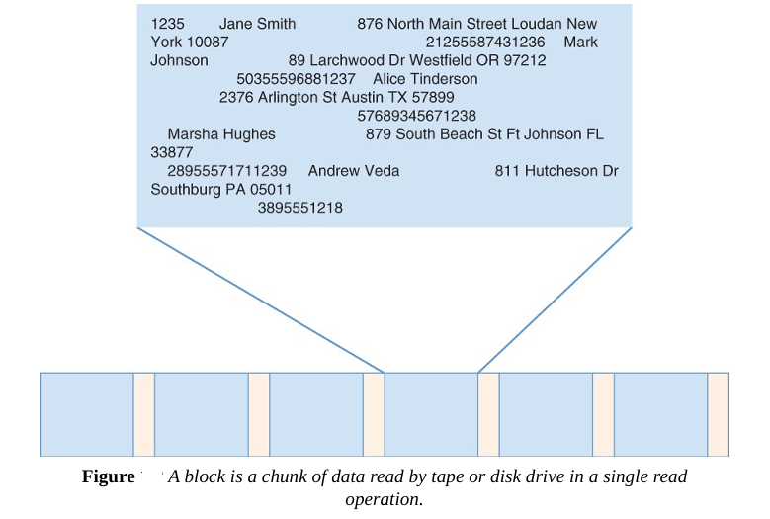
Introduction : Early Database Management Systems
Sequential access
The programmers working on the project may decide to leave a fixed amount of storage space for each customer:
• Customer ID—10 characters • Customer name—40 characters • Customer address—100 characters • Customer phone number—10 characters
To store each customer’s information, 160 characters are required. If a block on the tape is 800 characters long, you could store five customer records in each block.

Slide 9
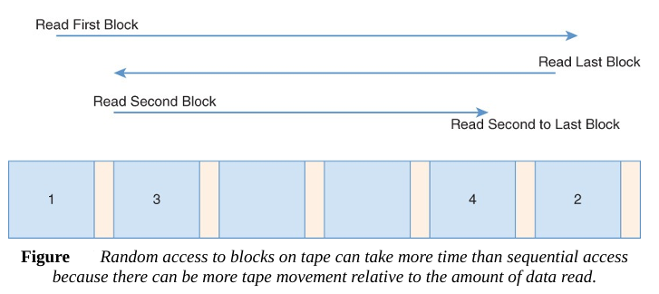
Introduction : Flat File System
Random access Sometimes it is necessary to access data on different parts of the tape. For example, looking up the addresses of several customers may require moving the tape to several different positions.
Limitations
Program Data Dependence
Redundancy
No Metadata
No Customized Query
Sequential Search

Slide 10
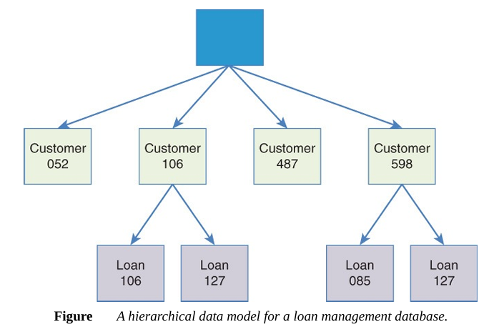
Introduction : Hierarchical DBMS
Hierarchical data models address sequential search problem by organizing data in a hierarchy of parent-child relationships.
Limitations
If network ? Redundancy
No Aggregation
In the case of two customers on the same loan, the hierarchical data management system would have to duplicate information about the loan under both customers. This creates three problems. First, it makes inefficient use of storage space to duplicate data.

Slide 11
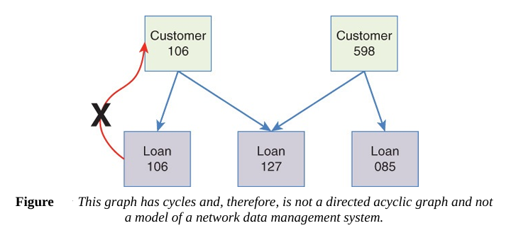
Introduction : Network DBMS
Network (Graph) data models allow for multiple parents, such as two customers on a loan. It can also represent two customers with two loans without duplicating data.
Constraints -- DAG not Graph
Directed Edge
Acyclic
Limitations
Difficult Schema so maintain also
Difficult to update
Inconsistent Data

Slide 12
Introduction : R-DBMS
Relation (Formal/ E.F.Codd , 1970) Relational databases were based on a formal mathematical model that used relational algebra to describe data and their relations.
Relational databases separated the logical organization of data structures from the physical storage of those structures.
RDBMS is an application made up of multiple programs that manage data and allow users of the application to add, update, read and delete data.
Common language for DDL, DML, DQL,DCL, TCL ---- SQL
END user does not require SQL.
Local Storage vs Shared network storage
Indexes to data
Separate storage management system
Memory interaction (swaping)
Data Dictionary (meta data) – schemas, tables, columns, indexes, constraints, views etc.
Consistent Data
Easy to Design/Implement/Update
No Redundancy
Program-Data Independence

Slide 13
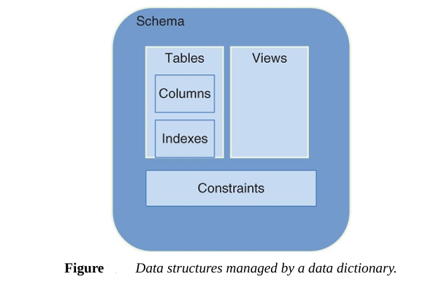
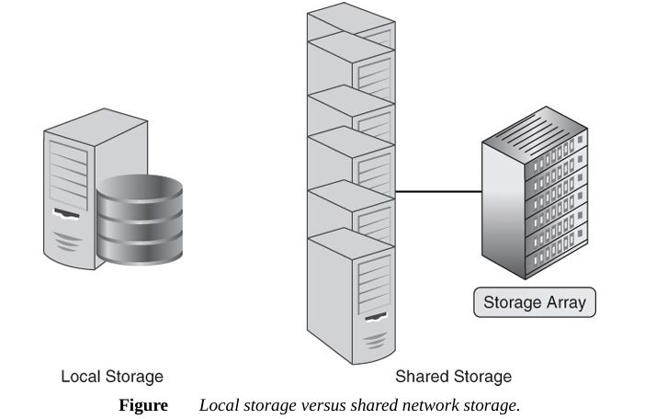
Introduction : R-DBMS
Separate Storage System
Separate Data Dictionary
Limitations
Large volumes of read and write operations
Low latency response times
High availability
All Non-Functional Requirements
Denormalization instead scaling
Low Performance if multiple servers

Slide 14
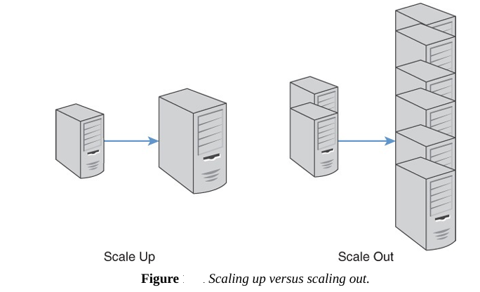
Introduction : No-SQL DBMS
No-SQL : A data management systems that are particularly important for large-scale data management tasks
Characteristics
Scalability : Scale-out, Scale-up – Horizontal vs Vertical Scaling
Cost
Flexibility
Availability
Scaling out is more flexible than scaling up. Servers can be added or removed as needed when scaling up.
NoSQL databases are designed to utilize servers available in a cluster with minimal intervention by database administrators.
As new servers are added or removed, the NoSQL database management system adjusts to use the new set of available servers.
Database Migration

Slide 15
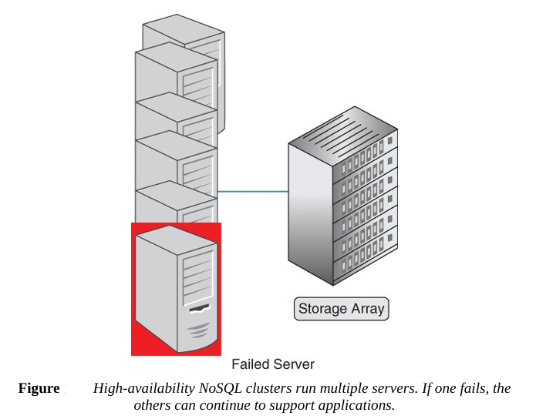
Introduction : No-SQL DBMS
No-SQL : A data management systems that are particularly important for large-scale data management tasks
Characteristics
Scalability : Scale-out, Scale-up – Horizontal vs Vertical Scaling
Cost
Flexibility
Availability
NoSQL databases are designed to take advantage of multiple, low-cost servers.
When one server fails or is taken out of service for maintenance, the other servers in the cluster can take on the entire workload

Slide 16
Summary
NoSQL databases are non-relational database management systems that store data in a non-tabular format. They provide flexible schemas to store semi-structured and unstructured data. Traditional relational databases adhere to ACID (Atomicity, Consistency, Isolation, Durability) principles to ensure strong consistency and structured relationships between data. However, NoSQL databases have emerged as the solution for modern applications that handle big data, operate in distributed environments, and require real-time analytics due to their scalability, flexibility, high performance, distributed architecture, and cost-effectiveness.

Slide 17
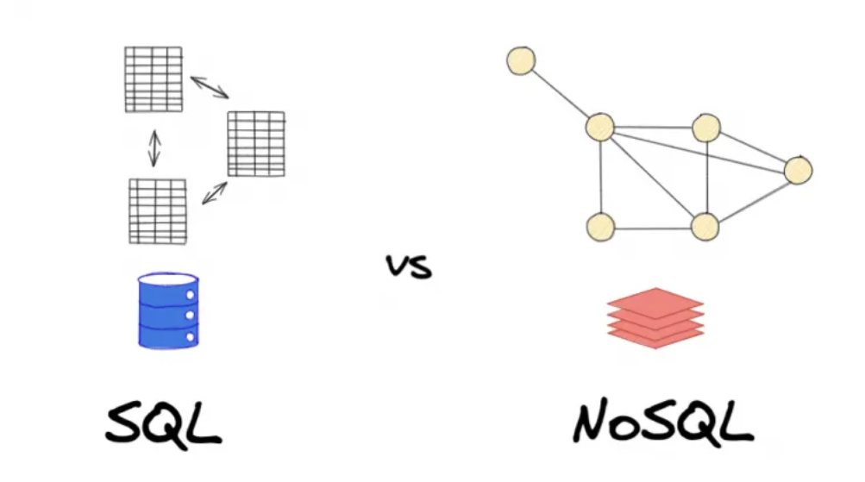
Summary

Slide 18
Categories
NoSQL databases fall into four broad categories: key-value, document, column family, and graph databases.
Key-value databases employ a simple model that enables you to store and look up a datum (also known as the value) using an identifier (also known as the key). BerkleyDB, released in the mid-1990s, was an early key-value database.
Document databases expand on the ideas of key-value databases to organize groups of key values into a logical structure known as a document. Document databases are high performance, flexible data management systems that are increasingly used in a broad range of data management tasks.
Column family databases share superficial similarities to relational databases. The name of the first implementation of a column family database, Google BigTable, hints at the connection to relational databases and their core data structure, the table. Column family databases are used for some of the largest and most demanding, data-intensive applications.
Graph databases are well suited to modeling networks—that is, things connected to other things. The range of use cases spans computers communicating with other computers to people interacting with each other.

Slide 19
Case Study
A transportation management company TransGlobal Transport and Shipping, is a fictional company with realistic requirements. As you examine each of the major types of NoSQL databases, you will consider how each can be applied to a specific application for TransGlobal Transport and Shipping.
The four major functionalities are
Building a shipment order
Managing customer manifests, or a detailed description of items in a shipment
Maintaining a customer database
Optimizing transportation routes

Slide 20
Memory Recall
If the layout of records in a file data management system changes, what else must change?
What kind of relation is supported in a hierarchical data management system?
a. Parent-child
b. Many-to-many
c. Many-to-many-to-many
d. No relations are allowed.

Slide 21
Memory Recall
What kind of relation is supported in network data management systems?
a. Parent-child
b. Many-to-many
c. Both parent-child and many-to-many
d. No relations are allowed.

Slide 22
Memory Recall
Give an example of a SQL data manipulation language statement.
Give an example of a SQL data definition language statement.
What is scaling up?
What is scaling out?
Are NoSQL databases likely to displace relational databases as relational databases displaced earlier types of data management systems?
Name four required components of a relational database management system (RDBMS).
Name three common major components of a database application.
Name four motivating factors for database designers and other IT professionals to develop and use NoSQL databases.

Slide 23
Revisit
Classic relational database (SQL) : Rows and tables, primary keys and joins, and the familiarity of SQL.
But as applications scale, evolve, and demand new levels of flexibility and performance, traditional relational databases don’t always hold up.
NoSQL databases are designed to handle unstructured or semi-structured data at scale.
They offer high availability, horizontal scalability, and flexible schemas.

Slide 24
Revisit
Classic relational database (SQL) :
SQL stands for Structured Query Language.
It is used to store data in tables (like Excel).
Data is organized in rows and columns.
It works best when your data has a fixed structure.
MySQL
PostgreSQL
Oracle DB
Microsoft SQL Server

Slide 25
Revisit
Classic relational database (SQL) :
Example Use Case:
Banking systems
Inventory management
Employee records

Slide 26
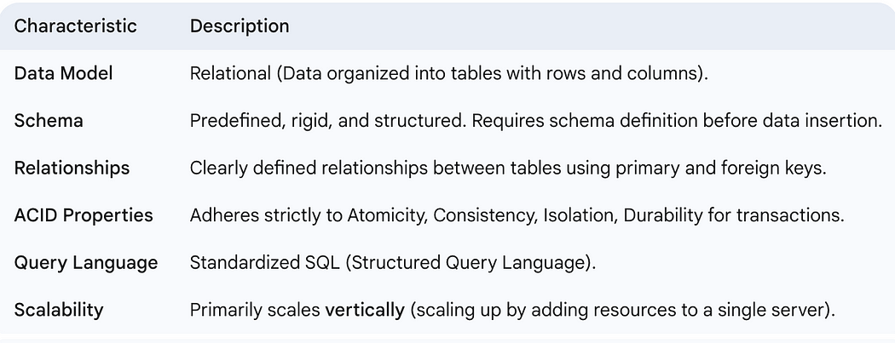
Revisit

Slide 27
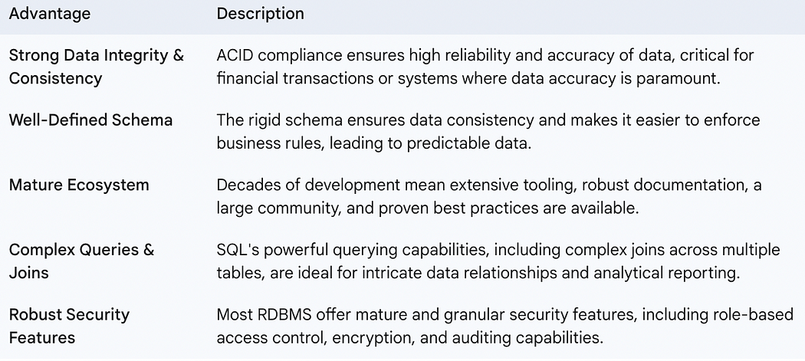
Revisit

Slide 28
Revisit
NoSQL:
NoSQL means “Not Only SQL”.
It stores data in formats other than tables.
It’s more flexible, and great for big, changing data.
It can handle large amounts of unstructured or semi-structured data.
Types of NoSQL
Document databases (MongoDB)
Key-value databases (Redis)
Column-family databases (Cassandra)
Graph databases (Neo4J)

Slide 29
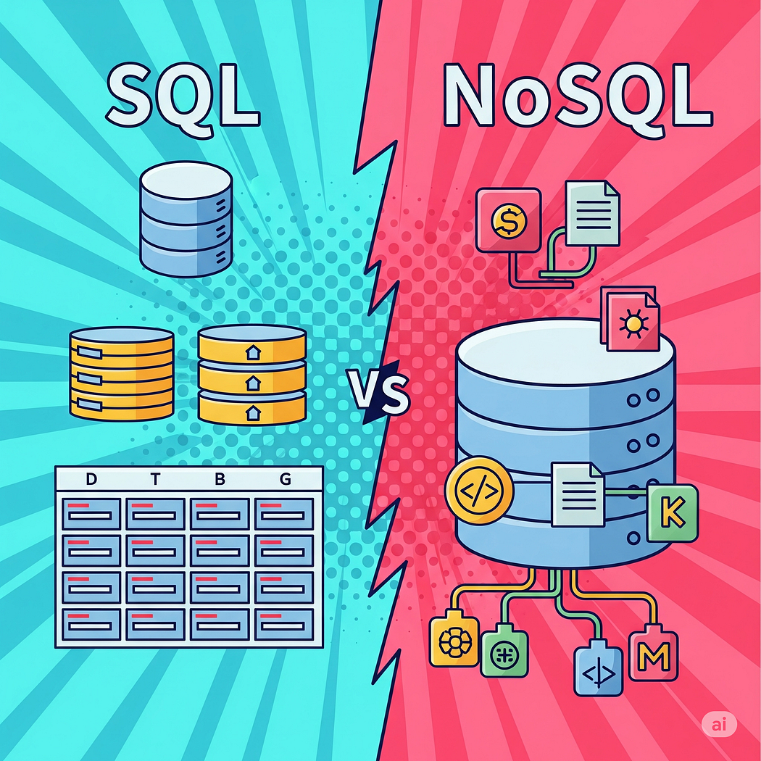
Comparison

Slide 30
Comparison : Factors Guiding Your Database Choice
Flexibility
Scalability
Performance
Data Retrieval Complexity
Business Requirements

Slide 31
Outcome
To enable students to understand the need for and use of NoSQL databases, various data models, and distributed architectures, and apply this knowledge to real-world applications.

Slide 32
Syllabus
Module-I: Introduction to NoSQL and Aggregate-Oriented Data Models
[14 Sessions L-6 P-8] [Understand]
Why NoSQL? The Value of Relational Databases, Getting at Persistent Data, Concurrency, Integration, A (Mostly) Standard Model, Impedance Mismatch, Application and Integration Databases, Attack of the Clusters, The Emergence of NoSQL, Aggregate Data Models; Aggregates, Example of Relations and Aggregates, Consequences of Aggregate Orientation, Key-Value and Document Data Models, Column-Family Stores, Summarizing AggregateOriented Databases. More Details on Data Models; Relationships, Graph Databases, Schema less Databases, Materialized Views, Modelling for Data Access.
Module: II: Distributed Data Systems and Consistency Models [12 Sessions L-6 P-6] [Analyze]
Distribution Models; Single Server, Sharding, Master-Slave Replication, Peer-to-Peer Replication, Combining Sharding and Replication Consistency, Update Consistency, Read Consistency, Relaxing Consistency, The CAP Theorem, Relaxing Durability, Quorums. Version Stamps, Business and System Transactions, Version Stamps on Multiple Nodes.

Slide 33
Syllabus
Module: III: Key-Value Stores and Map-Reduce Framework [12 Sessions L-6 P-6] [Analyze]
Map-Reduce, Basic Map-Reduce, Partitioning and Combining, Composing Map-Reduce Calculations, A Two Stage Map-Reduce Example, Incremental Map-Reduce Key-Value Databases, What Is a Key-Value Store, Key-Value Store Features, Consistency, Transactions, Query Features, Structure of Data, Scaling, Suitable Use Cases, Storing Session Information, User Profiles, Preference, Shopping Cart Data, When Not to Use, Relationships among Data, Multi operation Transactions, Query by Data, Operations by Sets.
Module: IV: Document-Oriented Databases and Use Cases [10 Sessions L-6 P-4] [Create]
Document Databases, What Is a Document Database?, Features, Consistency, Transactions, Availability, Query Features, Scaling, Suitable Use Cases, Event Logging, Content Management Systems, Blogging Platforms, Web Analytics or Real-Time Analytics, E- Commerce Applications, When Not to Use, Complex Transactions Spanning Different Operations, Queries against Varying Aggregate Structure.
Module: V: Graph Databases and Connected Data Solutions [8 Sessions L-4 P-4] [Apply]
Graph Databases, What Is a Graph Database?, Features, Consistency, Transactions, Availability, Query Features, Scaling, Suitable Use Cases, Connected Data, Routing, Dispatch, and Location-Based Services, Recommendation Engines, When Not to Use.

Slide 34
Books
Text Books:
T1. Sadalage, P. & Fowler, NoSQL Distilled: A Brief Guide to the Emerging World of Polyglot Persistence, Pearson Addision Wesley, 2012.
T2. Dan Sullivan, "NoSQL For Mere Mortals", 1st Edition, Pearson Education India, 2015.
(ISBN- 13: 978-9332557338).
Reference Books:
R1. Luc Perkins, Eric Redmond, Jim Wilson, "Seven Databases in seven weeks: A Guide to Modern
Databases and the NoSQL Movement", 2nd Edition, Pragmatic Bookshelf, 2018.
(ISBN- 13: 978-1680502534).
R2. Dan McCreary and Ann Kelly, "Making Sense of NoSQL: A guide for Managers and the Rest
of us", 1st Edition, Manning Publication/Dreamtech Press, 2013. (ISBN-13: 978-9351192022)
R3. Kristina Chodorow, "Mongodb: The Definitive Guide- Powerful and Scalable Data Storage",
2nd Edition, O'Reilly Publications, 2013. (ISBN-13: 978-9351102694).
WEB RESOURSES:
W1 - https://www.geeksforgeeks.org

Slide 35
Conclusion
This course is designed to ensure:
Strong conceptual foundation in NoSQL.
Robust technical and analytical skills.
Ethical and sustainable computing practices.
Alignment with NEP 2020, OBE, and SDGs.

